Slide 1


Threat Modeling

Slide 2

Company Profile
Medium-sized MSP providing services to a large number of SMEs across a variety of industries.
Services on offer are a consolidated internally developed management dashboard integrating Office 365, AWS, and Azure cloud platforms and reporting.

Slide 3



Method Families
Library
Goal-Oriented
Motivation

Slide 4
Lists and Library Methods

Slide 5
List and Library Methods
STRIDE (Spoofing, Tampering, Repudiation, Information Disclosure, Denial of Service, Elevation of Privilege)
STRIPED (STRIDE + Privacy)
LINDDUN (Linkability, Identifiability, Non-repudiation, Detectability, Information Disclosure, Content Unawareness, Privacy and Consent Noncompliance)
OWASP Top 10
Security Cards
ENISA threat taxonomy
MITRE ATT&CK Framework
And many, many others

Slide 6
Exercise – Threat Model

Slide 7
Key Checkout Request
Auth. & Work Mgmt
API Secret Store
API ACME Management Portal
User IAM Store
Key
API Integration Engine
Line of Trust
Job Msgs
Sync
Sync
AWS API
AWS IAM
Azure AD
Office 365 API
Azure API
Customer
ACME Admins

Slide 8
Goal-Oriented Methods

Slide 9
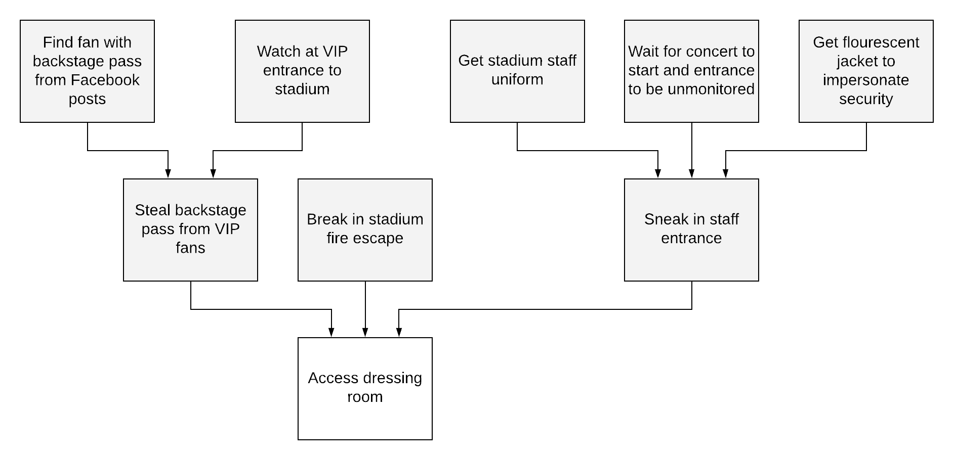
Goal or Asset Methods

Slide 10
Exercise – Threat Model

Slide 11
Motivation Methods

Slide 12

Motivation Methods

Slide 13
Exercise – Threat Model

Slide 14
Making it Universal

Slide 15
‘Universal’ Threat Model Lifecycle
Brainstorm
Filter
Vulnerabilities
Triage
Remediations
Risks

